Slide 1
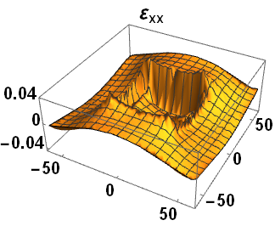
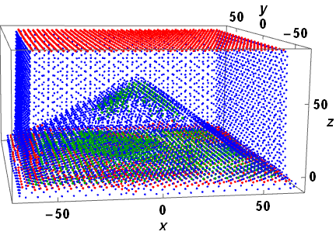
Atomistic approach of strain field in quantum dots*
Tiberius O. Cheche
University of Bucharest
ROCAM Bucharest, July 2024

Slide 2
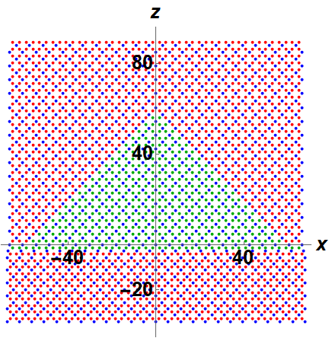
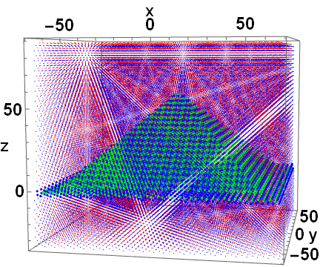
1a) Pyramidal QD
1b) Cross-section pyramidal QD
Fig. 1 Pyramidal InAs/GaAs QD: Initial Configuration - 87 365 atoms
1a) Pyramide of base b=120 Å, height h=60 Å, WL thickness 1ML=a_{InAs}/2 – the matrix atoms drawn as smaller size dots; 1b) thin layer of thickness a_{InAs}/2 of the, centered on the middle of structure and parallel to the xz plane. The unit length is 1Å.

Slide 3
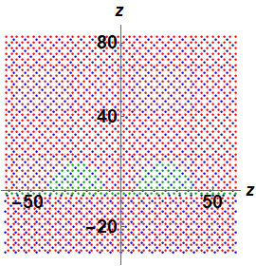
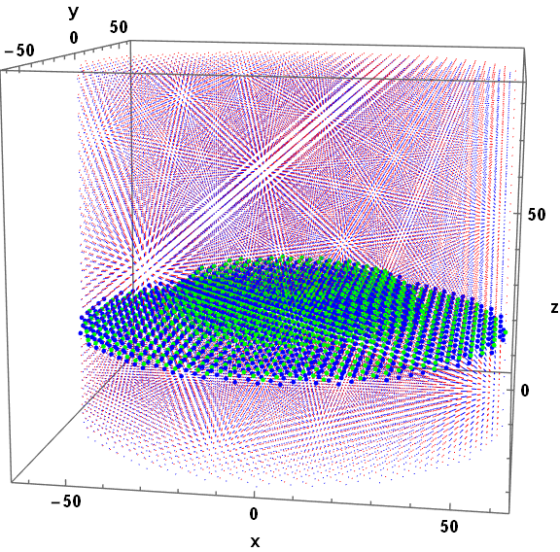
R_{t}
R_{q}
2a) Semi-torus
2b) Cross-section semi-torus QD
Fig. 2 Semi-torus InAs/GaAs QD: Initial Configuration - 55 042 atoms
2a) Semi-torus of R_{t}=24 Å, R_{q}=15 Å, WL thickness 1ML=a_{InAs}/2 – the matrix atoms drawn as smaller size dots; 2b) thin layer of thickness a_{InAs}/2 centered on the middle of structure and parallel to the xz plane. The unit length is 1Å.

Slide 4
The strain field is due to the lattice mismatch at the QD-matrix interface.
Methods of the strain field calculation in heterostructures:
continuum methods for structures much larger than the lattice constants;
atomistic methods for nano-crystals with thousands of atoms.
Similar results obtained by a) and b) in the limit of mesoscopic size (ten-thousand of nm).
AS_LBFG_v2 – new developed atomistic numerical code based on the L-BFGS (Limited-memory Broyden–Fletcher–Goldfarb–Shanno) algorithm simulates the strain field by minimizing the elastic energy of the heterostructure.

Slide 5
Few numerical codes for atomic relaxation in strained supercell heterostructures exist:
the molecular dynamics package LAMMPS;
the crystal energy package GULP.
The motivation for developing AS_LBFG_v2
Periodic boundary conditions (PBC) approach - often used in the context of ab initio and molecular statics atomic scale strain field simulations.
Drawbacks of PBC :
Apriori PBC induces a systematic error in calculation of the elastic energy of localized defect in a crystalline material due to the interaction between the defect and its own periodically translated image. To minimize this error, sufficiently large supercells are used in the molecular statics simulations of the strain field. On the one hand, increased number of atoms results in increased computational cost (see, e.g., the calculations with LAMMPS). On the other hand, PBC simulations require a fixed volume of the supercell (setting the displacement of the matrix at the boundary of the cell to zero), which is unphysical for closely spaced arrays [22]. In addition, large simulation cell requirement can not explain the strain tensor dependency on the capping thickness, as reported by experiment (see, e.g., ref. [3]). The limitations of PBC approach can be overcome by using a finite-sized matrix (FSM) model where a single quantum dot (QD) is embedded in a matrix of definite shape and size. Although a step forward for modeling accuracy, the FSM simulation still needs to solve the problem of unpassivated dangling bonds, which occur at the outer surface of structure [26].

